Slide 1
SACRED VESTMENTS

Slide 2
The practical server must know and understand the various vestments used in the liturgy.

Slide 3
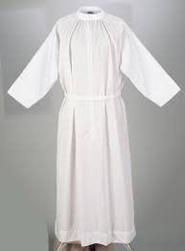
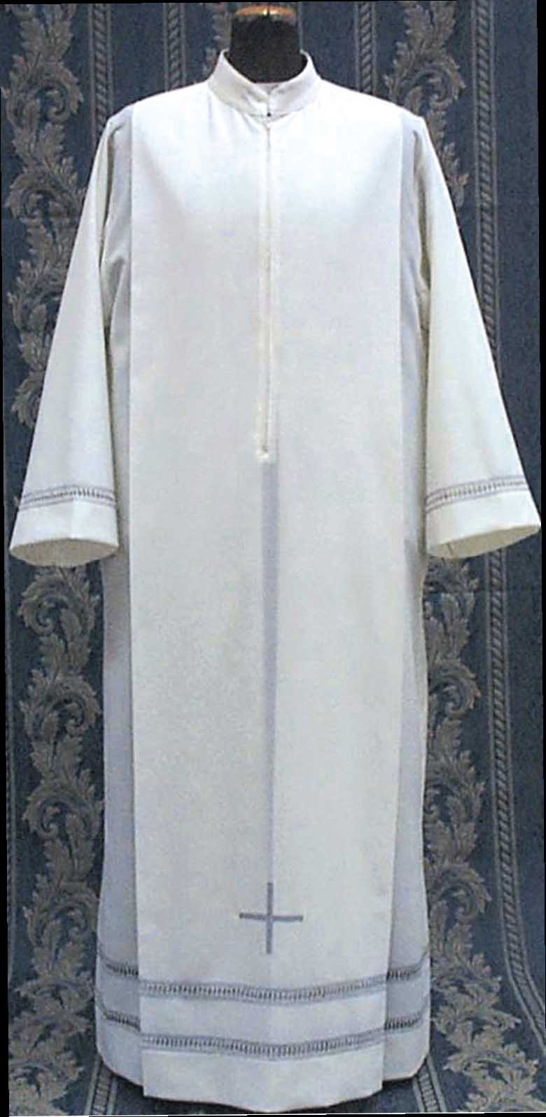
- is a white garment reaching the ankles. It is derived from the ancient Roman tunic and is a sign of purity. This word comes from the Latin word “white”.
THE ALB

Slide 4
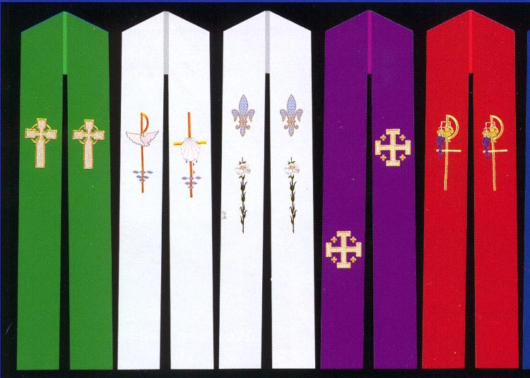
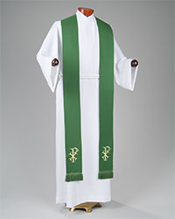
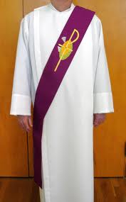
- is a distinctive sign of those who have received Holy Orders as they carry out the ministry in sacrament and worship. The priest wears this around the neck and hanging down in front. The deacon wears this on his left shoulder, crossing it like a sash under his right arm. It is of the color of the season or day. It stands for authority in the community.
THE STOLE

Slide 5
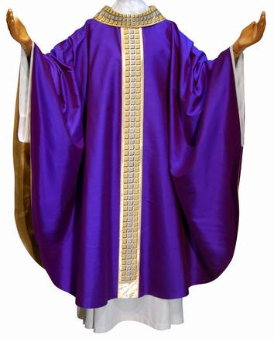
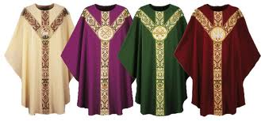
- is the major Eucharistic vestment, worn over the stole and the alb. It is the color of the season or day. There are various styles of chasuble. These styles developed over the years from the original form of outdoor cloak of the later Greek and Roman period. It stands for charity (“And over all these put on love, that is, the bond of perfection.” Col. 3:14).
THE CHASUBLE

Slide 6
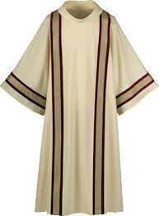
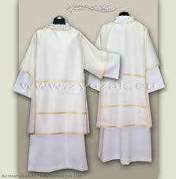
- is worn by the deacon. It resembles a large coat, of the color of the season or day. It is worn over the stole and the alb.
THE DALMATIC

Slide 7
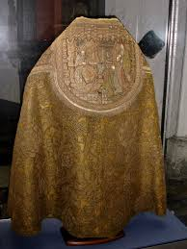
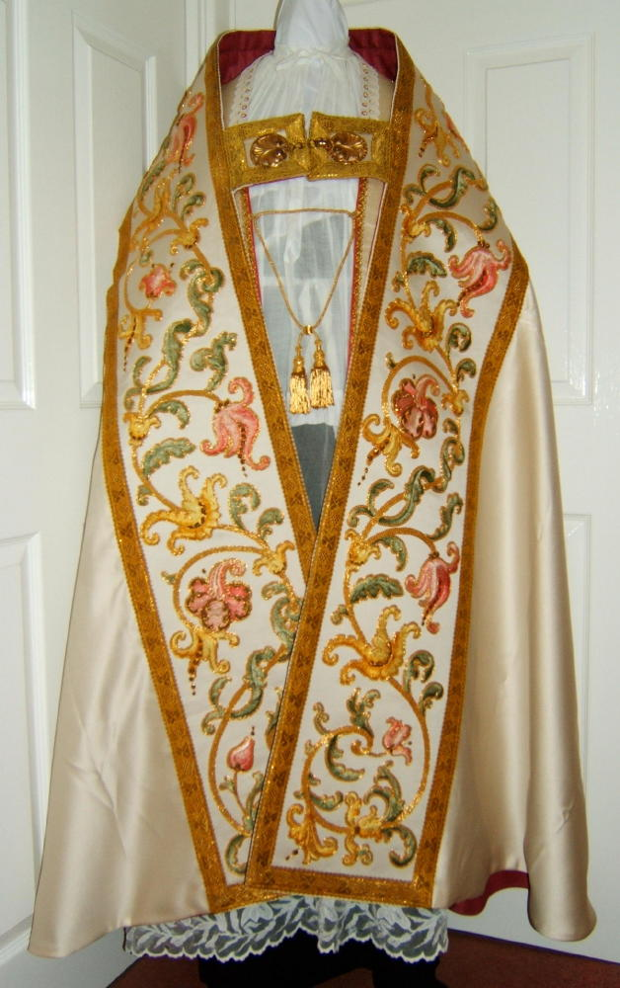
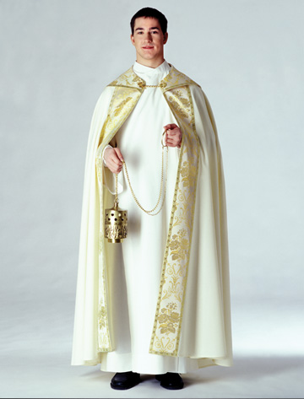
- is a large semi-circular cloak, held at the front by a clasp or band of fabric. It is used for solemn celebrations of the sacraments and for Benediction of the Blessed Sacrament.
THE COPE

Slide 8
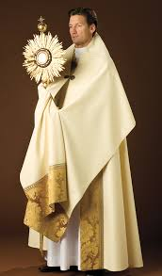
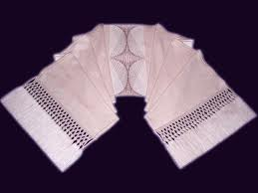
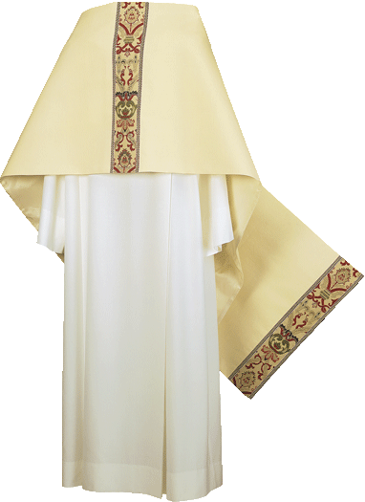
- is a large white shawl, worn around the shoulders while carrying the Blessed Sacrament in procession and while giving the Eucharistic blessing at the benediction.
THE HUMERAL VEIL

Slide 9
In addition to the basic vestments, the servers should also know the vestments and regalia used by a bishop. In liturgical celebrations, the vestments of the bishop are the same as that of the priest. In more solemn celebrations, it is fitting that he wears the dalmatic under the chasuble, especially during ordinations. The Pontifical insignia which he wears are the following: the ring, the crozier, the mitre, the pectoral cross and the pallium, if he has right on it.

Slide 10
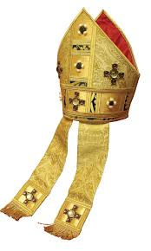
- is a double-pointed head-dress, with two lappets hanging at the back. It has been used by the bishops since the 12th century.
THE MITRE

Slide 11
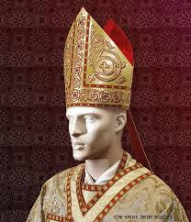
It is ordinarily used while: a. sitting b. addressing or blessing the people c. walking in procession (except in the presence of the Blessed Sacrament)
THE MITRE

Slide 12
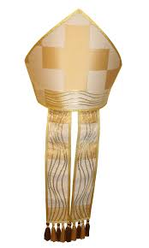
He does not use it at the Introductory Prayers of the Mass or Liturgy of the Hours, at the orations, the Prayer of the Faithful, Eucharistic Prayer, the Gospel, at hymns sung standing, nor in the presence of the exposed Blessed Sacrament.
THE MITRE

Slide 13
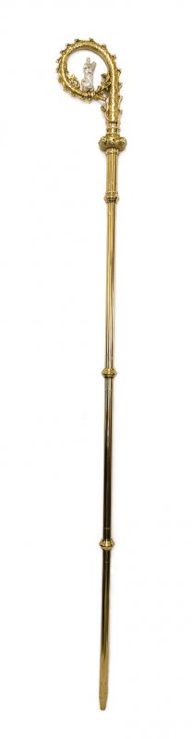
- usually with a shepherd’s crook at the top, is a sign of his pastoral office. The bishop carries it to remind us that he is the pastor and guardian of God’s people. If there are several bishops in a celebration, only the presiding one uses it.
THE CROZIER

Slide 14
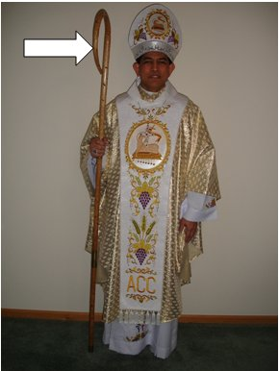
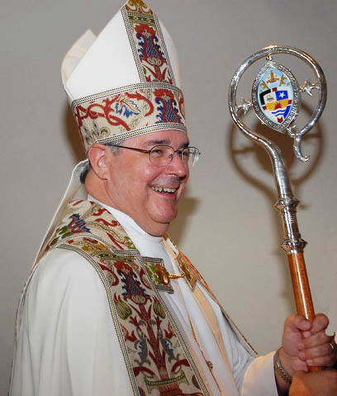
It is usually used while: a. walking in procession b. listening to the Gospel c. preaching the homily d. receiving the vows or professions of faith e. to bless persons, unless imposition of hand is required
THE CROZIER

Slide 15
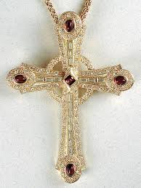
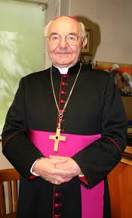
- is the bishop’s necklace. It is worn under the chasuble and the dalmatic, under the cope but above the mozeta.
THE PECTORAL CROSS

Slide 16
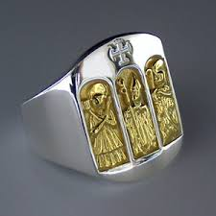
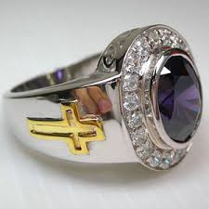
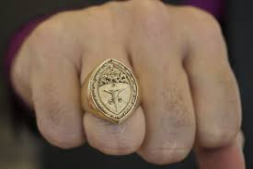
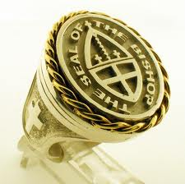
- is worn at all times as a sign that the bishop is wedded to Christ in the service of his Church as shepherd of the flock and should always be worn.
THE RING

Slide 17
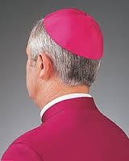
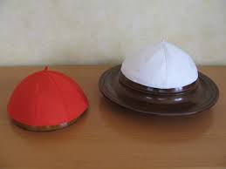
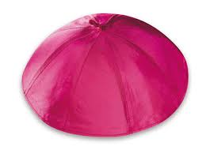
- is the small violet cap worn by the bishop.
THE SKULL CAP
or zucchetto

Slide 18
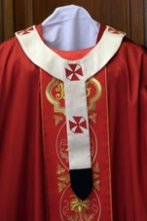
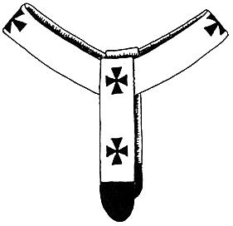
- is given to the residential archbishops. They wear it above the chasuble in their jurisdictional territory when pontificating solemnly and during ordinations, consecration of a church, dedication of an altar, blessing of an abbot or consecration of virgins.
THE PALLIUM

Slide 19
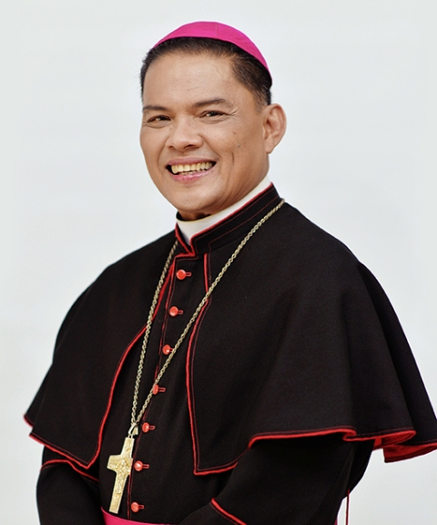
HIS EXCELLENCY GILBERT A. GARCERA, D.D. archbishop of lipa

Slide 20
Thank you for listening! ! !

